Slide 1


Supply Chain Disruption: The Real Cause of Inflation
Joshua Simangunsong
Johns Hopkins University – School of Advanced International Studies
Notes:
The topic of my capstone is – Supply Chain Disruption: The Real Cause of Inflation.

Slide 2
Research Question
How much of the increase in inflation is explained by supply chain disruption or monetary policy?
Notes:
COVID was a shock to the world and caused the world to halt, bringing economic disaster. To alleviate lots of the pain in the US, the Federal Reserve has executed monetary policy, specifically, quantitative easing to allocate funds. There are downsides to that policy, and traditionally, it increases inflation. However, because there was a disruption in the supply chain, not allowing anyone to consume, it brought scarcity of acquiring goods, which increased prices. So, my research question hones down on the discovery of the cause of inflation, and aims to demystify the question of how much of the increase in inflation is explained by supply chain disruption or monetary policy?

Slide 3
Importance
COVID-19 Exposed the Supply Chain
Shocked the supply chain and disrupted the timing of goods
Vessels were rerouted and containers missing
Exacerbated the prices of goods due to the disruption
Goods were in high demand and supply of them was lacking
Businesses shut down due to the lack of goods
Lack of labor
COVID-19 Led the Fed to Print Monies to Stimulate Economy
Federal Reserve has printed a total of $13 trillion
$5.2 T for COVID, $4.5 T for QE, $3 T for infrastructure
Annual Inflation rate is now 8.2%
Notes:
This research paper is important to know because COVID-19 has exposed a lot of the issues that the world was facing. Our supply chain is one of those issues. It caused vessels to be rerouted, confused ports about when vessels are berthing, and even caused containers to go missing. This caused huge delays in shipment. With goods in high demand and businesses at a halt, it also exacerbated the prices of goods. So, as a result, the Federal Reserve printed monies to stimulate the economy. They printed a total of $13 trillion dollars and currently, our annual inflation rate is 8.2%.
https://www.nasdaq.com/articles/money-printing-and-inflation%3A-covid-cryptocurrencies-and-more

Slide 4
Importance – continued.
Quantitative Easing in 2007 - 2008
During the Financial Crisis, quantitative easing was performed
Inflation was not declared
If there was quantitative easing during that time, why wasn’t inflation declared?
Notes:
Quantitative easing is nothing new. We’ve been conducting since the financial crisis in 2007 – 2008. However, inflation was not declared. So, why is that inflation is declared now, and not before? Quantitative easing was both performed in these two time frames.

Slide 5
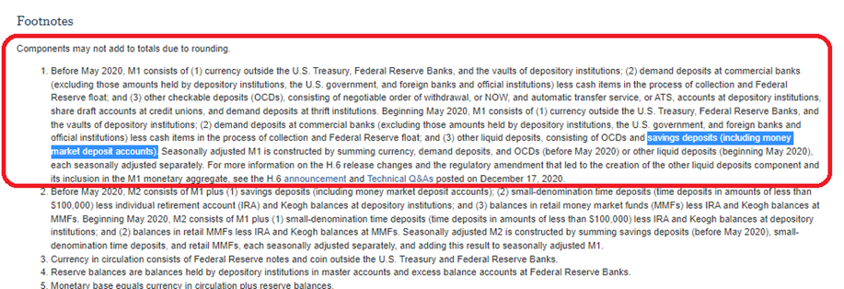
M1 – Methodology Change
Description of M1 Money Stock Methodology Change
As of May 2020, M1 Money Stock now consists of OCDs and saving deposits. As a result, the M1 Money Stock has increased significantly
Notes:
As of May 2020, the beginning of COVID, there was a methodology change in the M1 Money Stock, which measures the money supply. It has included OCDs and saving deposits, which were initially from the M2 Money Stock.

Slide 6
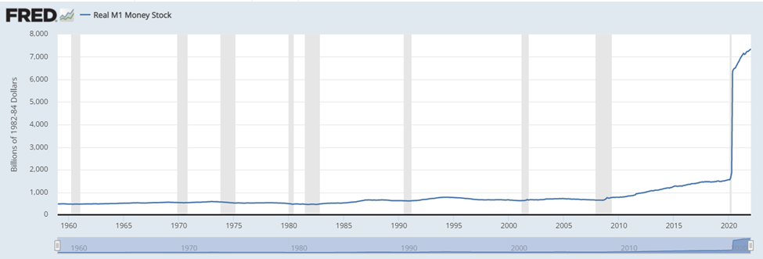
M1 – Methodology Change
M1 Money Stock
In a single month, the increase of there was an increase from $4.9 billion to $16.2 billion, not solely due to QE, but from the methodology change
Notes:
In just a single month, there was an increase from $4.9 billion to $16.2 billion in the M1 Money Stock. This is why there was such a significant jump in the M1 money supply during the time of COVID, which could be seen in this graph. So, was the increase in money supply solely from QE?

Slide 7
Monetary Policy – M1 Methodology Change
U.S. Federal Government passed the CARES Act on March 27th, 2020
$2 Trillion to all qualifying adults of up to $1200
Increased Money Supply
Theory of Money Equation – Milton Friedman
MV = PQ
In theory, if GDP and Velocity were to increase at a constant, any increase in the money supply should increase prices
Methodology Change in M1
Quantitative easing is measured in the Money Supply (M1)
In May 2020, the Fed decided to add saving deposits and checkable money funds, which were from M2, to M1
M1 is now M1 (before May 2020) + M2
This is seen in Figure 1
Notes:
According to Milton Friedman, and his theory of the Money Equation – MV=PQ (Money Supply times Velocity equals Prices times GDP). If GDP and Velocity were to increase at a constant, any increase in the money should increase prices. However, velocity did not increase during the time of COVID, which can be seen in the next slide.

Slide 8
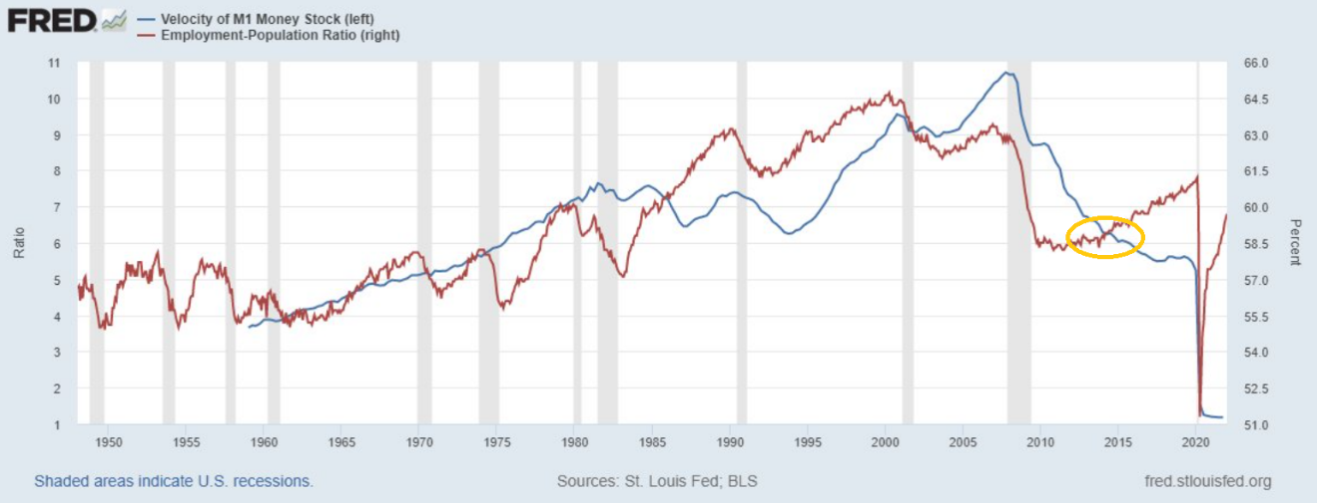
M1 – Methodology Change
Velocity of M1 Stock and Employment-Population Ratio
The decrease of Velocity in M1 Money Stock is not a result of unemployment
Despite the increase in employment, the Velocity of M1 Money Stock was still decreasing, which is circled in yellow
Notes:
The velocity of the M1 Money Supply has dramatically decreased, although there was an increase in the money supply (M1). So, then where did the money go if there was printing involved? Despite the increase in employment, the velocity of M1 money stock was still decreasing, which is circled in yellow. Employment no longer has strong explanatory power on the circulation of funds. So, the velocity of money does not correlate with unemployment ever since the financial crisis occurred in 2007 – 2008.

Slide 9
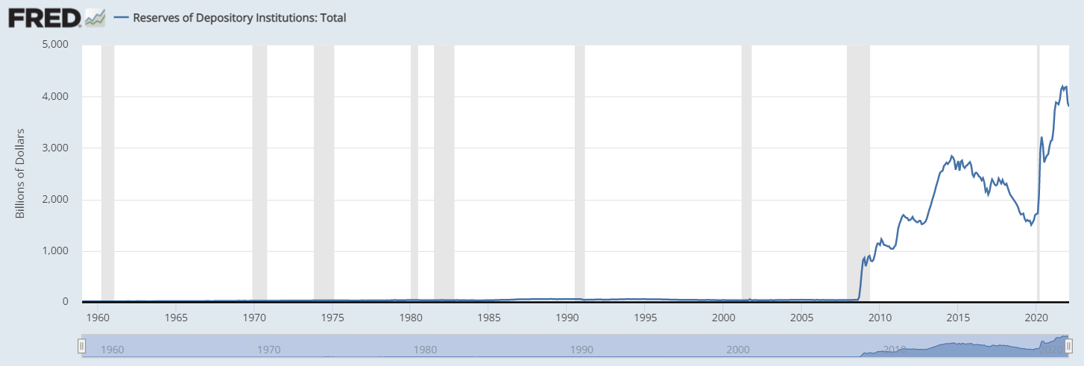
M1 – Methodology Change
Reserves of Depository Institutions: Total
The money being printed was not used by the general public
Institutions have accumulated the excess monies from the federal reserve
Notes:
As we can see, institutions have increased their reserves on deposits. The money that was being printed, was not being circulated by the general public; they’ve been accumulated by institutions.

Slide 10
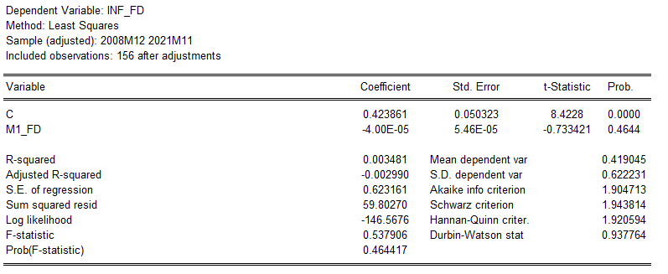
Regression – M1 Money Stock
Begs the Question:
Did the increase of the M1 Money Stock due to quantitative easing and does it have explanatory power for inflation?
Regressing for Inflation as M1 Money Stock as a dependent variable
M1 Money Stock is not significant at a 10% level and does not hold much explanatory power for inflation
Therefore, inflation is not to be entirely blamed on quantitative easing, but COVID
Notes:
This begs the question: Is the increase of the M1 money stock a result of quantitative easing and does it have explanatory power for inflation? Below I have regressed the first difference of inflation, against the first difference of the M1 money supply. We can see that statistically, it is not significant at a 10% level.
We have been seeing that the money supply has been increasing, due to QE, ever since the Financial Crises back in 2008, but we have not declared inflation during those times. However, we are seeing it now in the response to COVID-19 and it’s not solely because the Federal Reserve is conducting quantitative easing. Therefore, inflation is not to be blamed for quantitative easing, but COVID. Specifically, due to the problem of the disruption of the supply chain due to COVID.

Slide 11
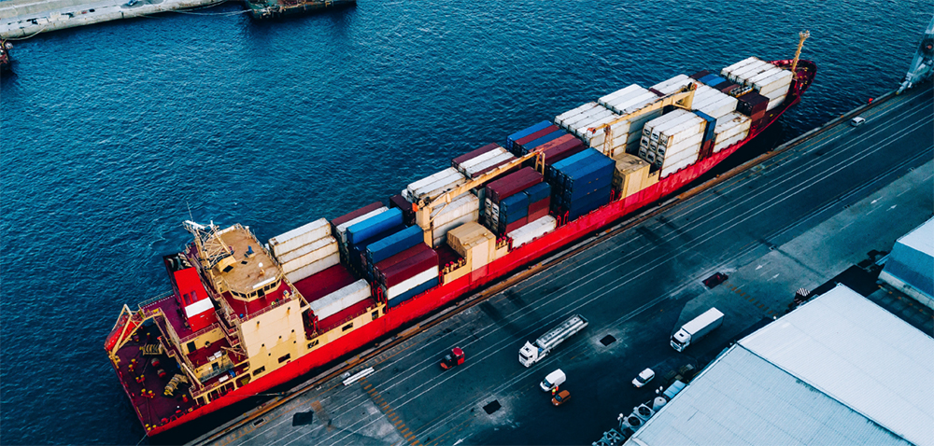
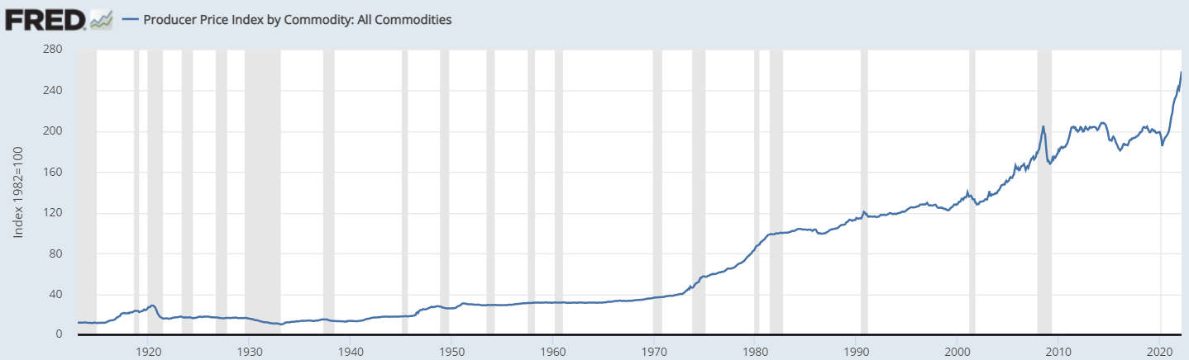
Disruption in the Supply Chain
COVID-19 Disrupted the Supply Chain
Changed trading pattern between countries
Trade imbalances
Immobilized individuals to conduct business
Items became scarce
Containers shipped to the wrong places
Commodity Prices
Commodity prices have skyrocketed, which is illustrated on the right
Final goods have dramatically increased due to the disruption
Notes:
COVID 19 has affected the way we conduct trade globally. Since the globe has minimized social contact, businesses were completely shut down and as a result, it had changed trading patterns between countries. It completely halted shipment, even mid-way through, when these vessels were being rerouted,causing confusion. In the midst of the confusion, containers were being shipped to the wrong places as well. This caused trade imbalances and a ripple effect in logistics. Naturally, items became scarce and prices increased. Commodity prices have skyrocketed during COVID, which is illustrated on the right. They have reached historical highs because there were shortages in containers due to the changes in trade. Moreover, there was also a shortage of labor. Mixed with the shortages in containers and miscommunication, it had caused major delays in shipment. We can see this data from the Port of Los Angeles in the next slide.

Slide 12
Disruption in the Supply Chain – Port Data
Port of Los Angeles Data of Vessels
Year | Average POLA Vessels at Anchor | Average POLA Vessels at Berth | Average POLA Vessels Departed | Average Days at Berth | Average Days at ANC + Berth
2019 | 0 | 9 | 3 | 3 | 3
2020 | 2 | 10 | 3 | 3 | 3
1/2/2020 - 2/28/2020 | 0 | 7 | 2 | 3 | 3
3/2/2020 - 12/31/2020 | 2 | 11 | 3 | 3 | 4
2021 | 17 | 16 | 3 | 6 | 13
During COVID – 2020 & 2021
The average vessels at berth have increased during the time of COVID
The average days at ANC and Berth, time spent at the port, have increased
These vessels are waiting to be cleared to unload the containers - an exact result of the container crises we currently face due to the pandemic
Notes:
With vessels and containers being misdirected and an increase in demand, there was a dramatic increase in vessels and the amount spent at the Port of Los Angeles. This had caused major traffic in this port and held true with other ports as well. It was so bad that there were lines across the ocean for these vessels to be docked. The average vessels at berth have increased, causing traffic. Also, the average days at anchor and Berth have increased, which is more time spent at the port to unload. These vessels are waiting to be cleared so containers can be unloaded. This is the result of the container crisis we are and were facing during the pandemic. This is why shipment was delayed.

Slide 13
Disruption in the Supply Chain - Containers
Port of Los Angeles Data - Containers
Port of Los Angeles
Year | Loaded Imports | Empty Imports | Total Imports | Loaded Exports | Empty Exports | Total Exports | Total TEUs
2019 | 4,714,266 | 149,579 | 4,863,845 | 1,756,177 | 2,717,611 | 4,473,788 | 9,337,632
2020 | 4,827,040 | 49,311 | 4,876,351 | 1,531,406 | 2,805,639 | 4,337,045 | 9,213,396
2021 | 5,513,286 | 26,707 | 5,539,993 | 1,184,145 | 3,953,472 | 5,137,617 | 10,677,610
Port of Los Angeles
Total amount of empty containers in 2021 was 5,164,324 from 4,386,356 in 2020 – this was an increase of 18%.
Port of Long Beach
Year | Loaded Inbound | Loaded Outbound | Total Loaded | Empties Inbound | Empties Outbound | Total Empties | Total Throughput
2019 | 3,758,438 | 1,472,802 | 5,231,240 | 74,706 | 2,326,087 | 2,400,792 | 7,632,032
2020 | 3,998,340 | 1,475,888 | 5,474,227 | 146,370 | 2,492,718 | 2,639,088 | 8,113,315
2021 | 4,581,846 | 1,437,916 | 6,019,762 | 154,289 | 3,210,317 | 3,364,606 | 9,384,368
Port of Long Beach
Total amount of empty containers was 2,639,088 in 2020, in 2021, 3,464,606 – a 27% increase
Caused a huge imbalance between the total amount of inbounded and empty containers that were outbound
Notes:
In the port of Los Angeles, the total amount of empty containers in 2021 was approximately 5.1 million, from 4.3 Million in 2020. This was an increase of 18%. Similarly, in the Port of Long beach, in 2020, there was a total of 2.6 million empty containers and 3.4 million in 2021 – a 27% increase. This is a huge trade imbalance between the total amount of inbounded and empty containers that were outbound. This means that there are inefficiencies in logistics.

Slide 14
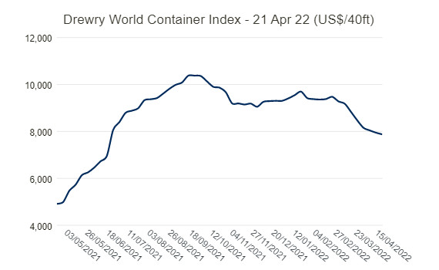
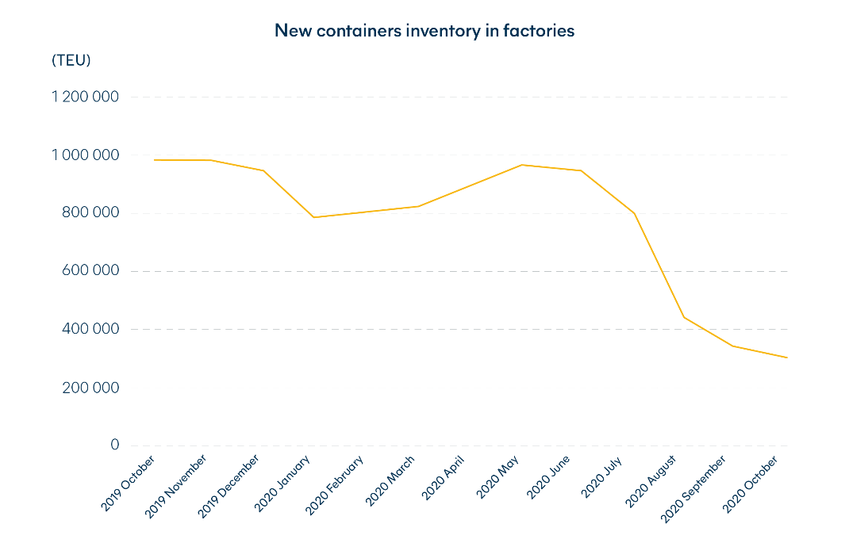
Disruption in the Supply Chain - Containers
Increased Costs per 40 Ft Container
September 2021, freight costs reached an all-time high of $10,375 per 40-foot container
Bottlenecks and trade imbalances have increased container costs
Costs are passed down to the consumers
Inventories of Containers in Factories
With prices at all-time highs and from lack of demand, inventory of containers has been drastically cut during COVID
Container factories have also reduced their production
There are more containers scrapped than produced
Notes:
These inefficiencies caused bottlenecks and the trade imbalances have increased container costs, which affected the prices of final goods since the costs are passed down to consumers. In September 2021, freight costs reached an all-time high of $10, 375 per 40-foot container. Additionally, factories have cut down the inventory of new containers because of the lack of demand since prices were so expensive. The lack of demand for containers were so low that there were more containers being scrapped than produced.

Slide 15
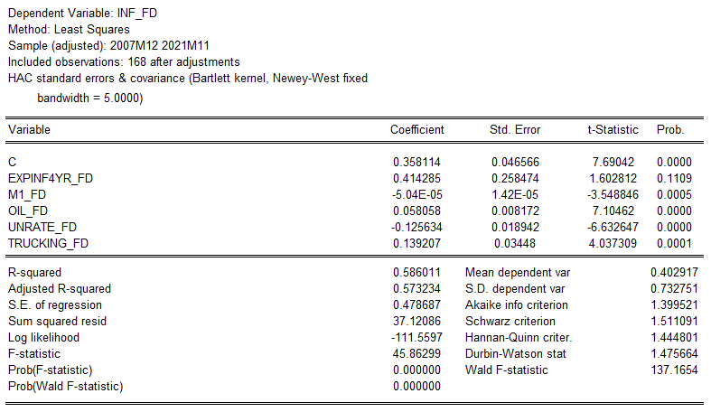

Model and Regression Results
$$∆inflation= α_{0}+∆InflExpβ_{1}+∆MSβ_{2}+∆Oilβ_{3}+∆Unempβ_{4}+∆Truckingβ_{5}$$
Model
The model is regressing for the first difference of inflation and its independent variables were selected for its explanatory power of inflation. The PPI of Freight Trucking is included in the model because it is highly relevant to the supply chain disruption effects. The sample size is from late 2007 to late 2021 and regressed using HAC standard errors to fix serial correlation.
Independent Variables
First difference of each variable to make the regression stationary
Infl Exp – 4-Year Inflation Expectation
MS – Money Supply
Oil
Unemployment
Trucking
Results
Nearly all the variables are statistically significant at a 1% level
Expected inflation rate is almost significant at a 10% level
Notes:
In my model to test my hypothesis, that inflation is caused by the disruption in the supply chain, rather than quantitative easing is displayed above. The model is regressing for the first difference of inflation. These independent variables are also first-differenced. They are the 4-year expected inflation rate, Money Supply (M1), Oil, Unemployment, and PPI Freight Trucking. PPI Freight Trucking is included in the model because it is to explain the supply chain disruption effects. The sample size is from late 2007 to late 2021, and regressed using the HAC standard errors to fix serial correlation and any spurious regressions.
As a result, nearly all the variables are statistically significant at a 1% level, except the expected inflation rate, which is almost significant at a 10% level.

Slide 16
Model and Regression Results
$$∆inflation= α_{0}+∆InflExpβ_{1}+∆MSβ_{2}+∆Oilβ_{3}+∆Unempβ_{4}+∆Truckingβ_{5}$$
Results
Expected Inflation: If to increase by 1 percentage point, inflation is to increase inflation by 40 percentage points, which is almost significant at a 10% level.
M1 Money Stock: If to increase by 1 percentage point, inflation is to increase by virtually 0, and significant at a 1% level. Oil: If to increase by 1 percentage point, inflation is to increase by .5 percentage points, significant at a 1% level.
Unemployment Rate: If to increase by 1 percentage point, inflation is to decrease by 12.5 percentage points, significant at a 1% level.
Freight Trucking: If to increase by 1 percentage point, inflation is to increase by 13.9 percentage points, significant at a 1% level.
Notes:
These are the results. If we were to mainly focus on the money supply and the PPI of Freight Trucking, we can see that they are both statistically significant at a 1% level. If M1 Money Stock is to increase by 1 percentage point, inflation is to increase by virtually 0. However, if the PPI of Freight Trucking were to increase by 1 percentage point, inflation is to increase by 13.9 percentage points. This is a profound discovery.

Slide 17
Conclusion
In conclusion, the results of the regression align with my sentiments on inflation. The PPI for the industry of freight trucking, which represents the disruption of the supply chain, increases inflation more than the money supply has and is statistically significant at a 1% level. This is profound in the sense that the majority believes that inflation was caused by QE. There are more reasons for the disruption of the supply chain due to COVID being the cause of inflation. Therefore, this is a case that quantitative easing is not the sole reason for inflation, and arguably, not a case at all. The real cause of inflation is the disruption of the supply chain.
Notes:
In conclusion, the results of the regression align with my sentiments on inflation. The PPI for the industry of freight trucking, which represents the disruption of the supply chain, increases inflation more than the money supply has and is statistically significant at a 1% level. This is profound in the sense that the majority believes that inflation was caused by QE. There are more reasons for the disruption of the supply chain due to COVID being the cause of inflation. Therefore, this is a case that quantitative easing is not the sole reason for inflation, and arguably, not a case at all. The real cause of inflation is the disruption of the supply chain.

